Slide 1
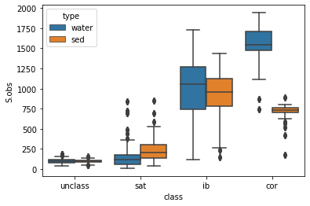
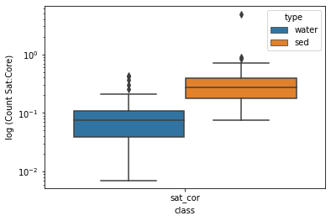
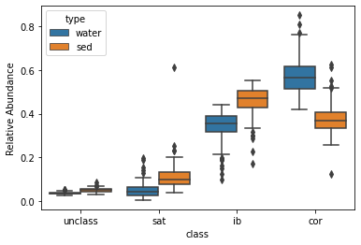
Water is on average less compound-rich than sediment (S.obs & S.Chao1, see Jupyter Notebook)
There is a big difference in the number of core species in water and sediment (i.e., water is more homogenous) with fewer satellite species on average in water samples.
The ratio of satellite:core higher in sediments
The relative abundance tells the same story
Notes:
The alpha diversity is the within-sample diversity.
S.obs is the number of molecular formulae observed in the set at least once
Chao1 Assumes that the number of observations has a poisson distribution and corrects for variance. (This is the species richness plus an estimate of molecular formulae present in the community but not observed)

Slide 2
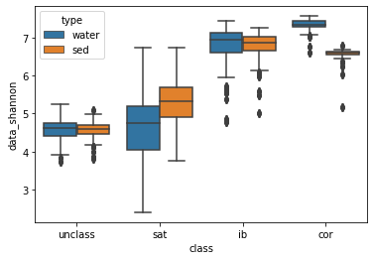
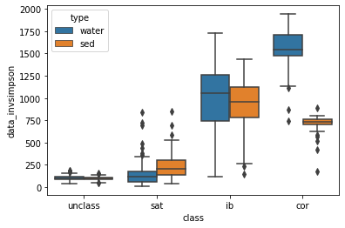

Slide 3
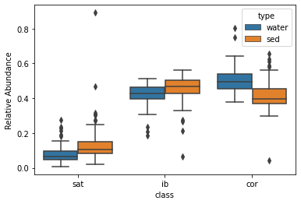
Difference between mf and mass
… pretty marginal (mass is more conservative)
mf
mass

Slide 4
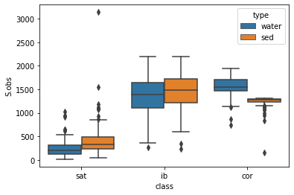
mf
mass

